Slide 1

Basic Details of the Team and Problem Statement
Ministry/Organization Name/Student Innovation:
AICTE, MIC-Student Innovation
PS Code: SIH1491
Problem Statement Title: Developing solutions, keeping in mind the need to enhance the primary sector of India - Agriculture and to manage and process our agriculture produce
Team Name: Farm Force
Team Leader Name: Rohan Yadav
Institute Code (AISHE): C-36117
Institute Name: Oriental Institute Of Science And Technology
Theme Name: Kisan Kalyaan

Slide 2
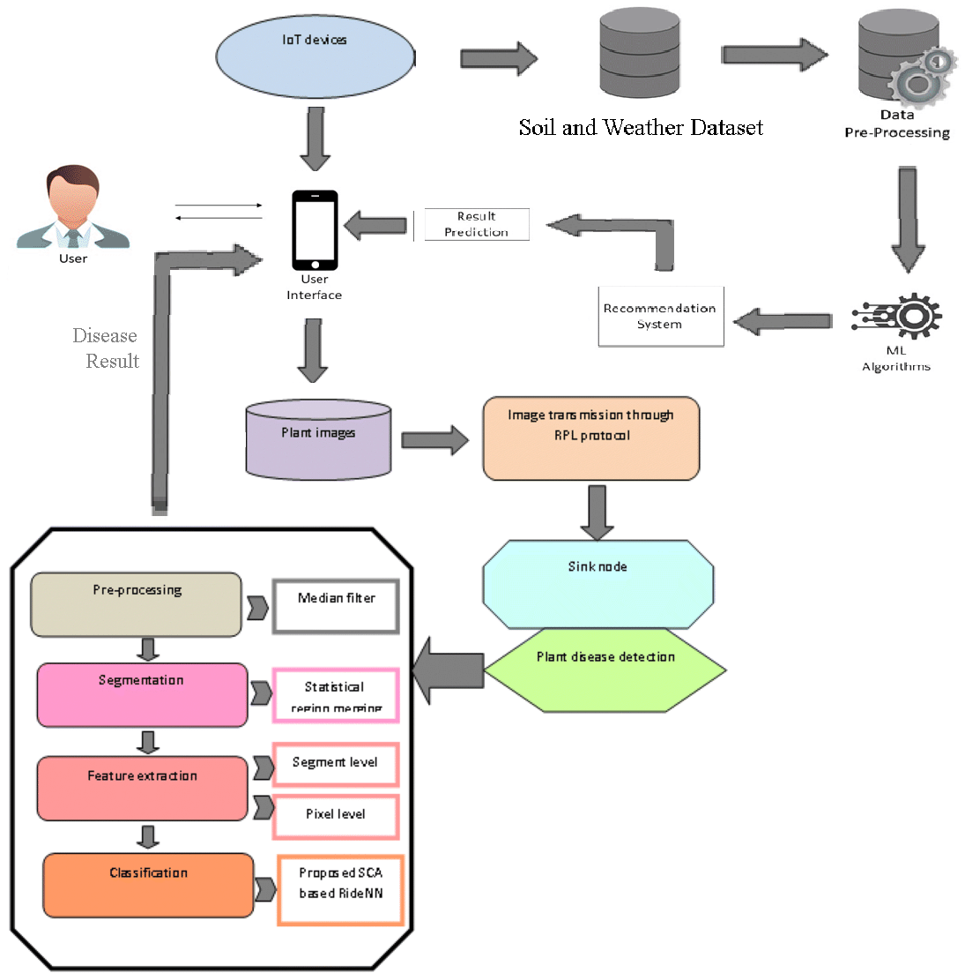
Idea/Approach Details
IDEA & SOLUTION
The Smart IOT based Farming Application which performs Crop, Fertilizer & Disease Predictor System is an innovative agricultural technology project aimed at revolutionizing modern farming practices. This system leverages cutting-edge technologies such as machine learning and data analytics to optimize crop production, reduce fertilizer waste, and prevent crop diseases.
Predicts crop diseases and offers personalized solutions through leaf analysis.
Recommends ideal crops and fertilizers based on soil and climate conditions.
Fosters a farming community for knowledge sharing and support.
Facilitates secure transactions and trade in an integrated farm store.
Implements robust user authentication for data security.
Empowers farmers to optimize their practices and increase crop yields.
Technology used | Purpose
React Native | Frontend Development
Python Flask | Backend Development
Mangodb,Firestore | User Database
Opencv | Image Processing
Deep Learning(CNN Model)with Tensorflow,jupyter notebook | Deep Learning Model Building (Image classification)
Kaggle,Google Dataset | Data Collection
Render | Model Deployment
Python,Scikit Learn | Machine Learning Model

Slide 3
Idea/Approach Details
USE CASES
SHOW-STOPPER
Disease Prediction and Leaf Analysis:The app should have a feature that allows farmers to upload images of diseased leaves or plants.
Crop Recommendation: The app should take into account factors like soil quality, climate, and previous crop history.
Fertilizer Recommendation: Based on soil tests and crop type, the app should provide fertilizer recommendations to optimize crop growth.
Farm Community and Knowledge Sharing: Create a community forum or chat feature where farmers can interact, ask questions, and share knowledge.
Farm Store and Marketplace: Include an in-app marketplace where farmers can buy/sell agricultural products, tools, seeds, and equipment.
Authentication and User Profiles: Implement a secure user authentication system to protect user data and transactions.
Increased Crop Yield and Quality: Farmers can expect increased crop yield and improved crop quality by using the app to make informed decisions about crop care and management.
Improved Crop Health:Early detection of diseases and pests can lead to timely intervention, preventing the spread of diseases and minimizing crop damage
Data-Driven Decision Making: Farmers can make data-driven decisions based on the app's recommendations, which can lead to more efficient and effective crop management.
Knowledge Sharing: The app can facilitate knowledge sharing among farmers by allowing them to share their experiences and insights through a community feature.
Revenue Generation: Developers can generate revenue through various monetization strategies, such as in-app advertisements, subscription models, or selling premium features.

Slide 4
Team Member Details
Team Leader Name: Rohan Yadav
Branch (B. Tech): Stream (CSE-AIML): Year (III):
Team Member 1 Name: Vikas Verma
Branch (B. Tech): Stream (CSE-AIML): Year (III):
Team Member 2 Name: Zeeshan Khan
Branch (B. Tech) : Stream (CSE-AIML): Year (III):
Team Member 3 Name: Raj Patil
Branch (B. Tech): Stream (CSE-AIML): Year (III):
Team Member 4 Name: Sabiha Khan
Branch (B. Tech): Stream (CSE-AIML): Year (III):
Team Member 5 Name: Deepak Kumar Sain
Branch (B. Tech): Stream (EC): Year (IV):
Team Mentor 1 Name: Sreeja Nair
Category (Academic): Expertise (AI/ML/Blockchain etc):
Team Mentor 2 Name: Uma Vishwakarma
Category (Academic): Expertise (AI/ML/Blockchain etc):

